Slide 1
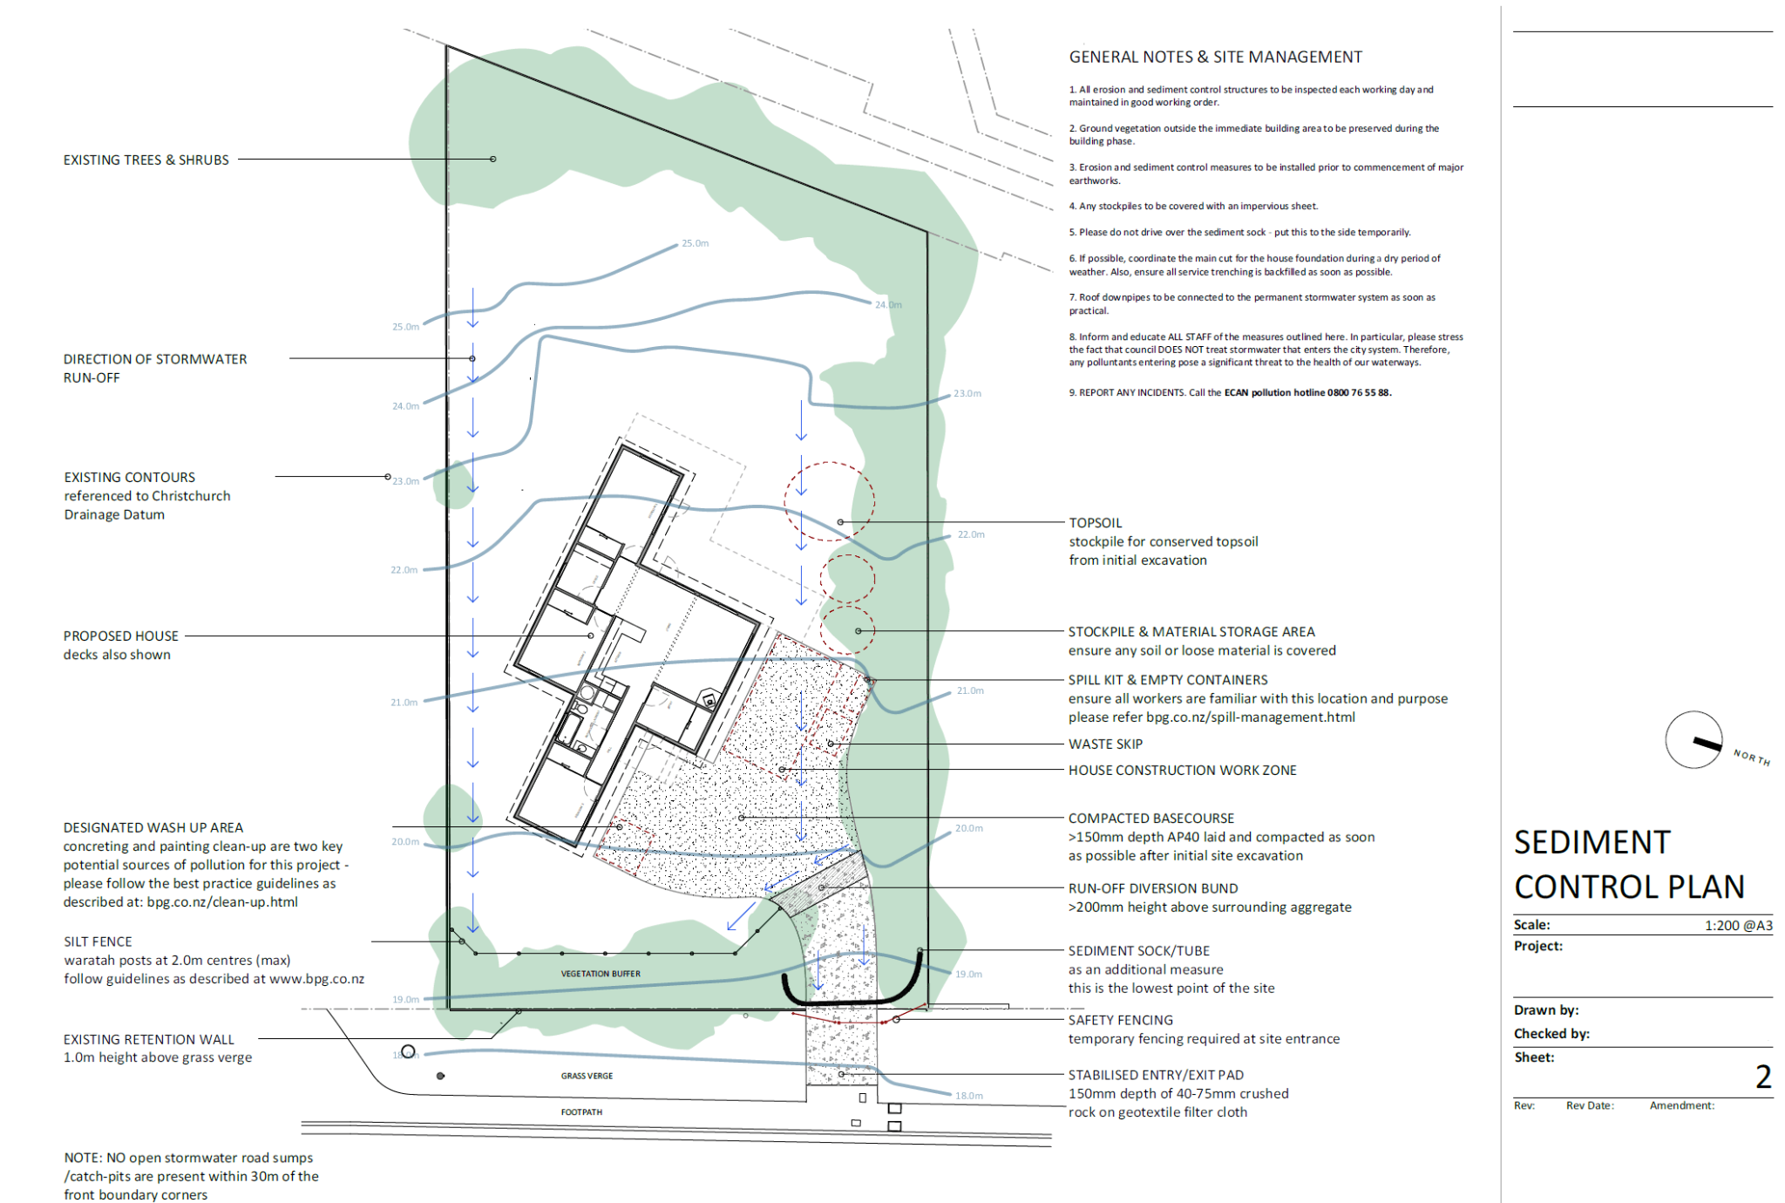
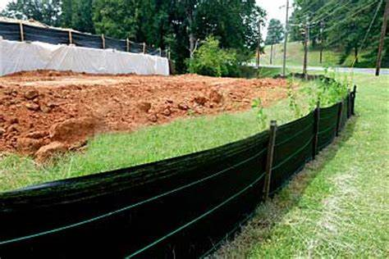

RESOURCES FOR SEDIMENT & EROSION CONTROL
PLAN REVIEW

Slide 2

All Erosion and Sediment control plans submitted for review and approval for projects located in Frederick County, must adhere to the current 2011 Maryland Department of the Environment’s Standard and Specifications for Soil Erosion and Sediment Control.
2011 Maryland Standards and Specifications for Soil Erosion and Sediment Control

Slide 3
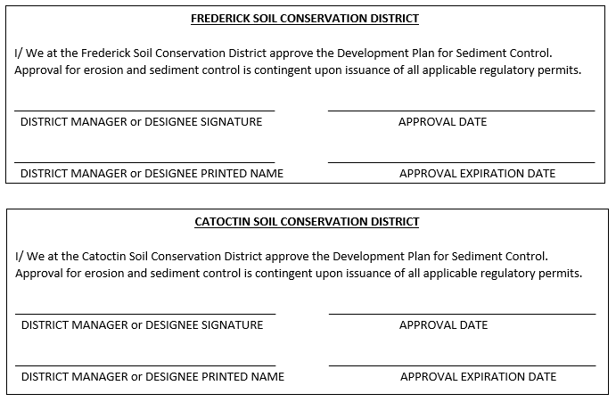
APPROVAL INFORMATION
The Catoctin and Frederick Soil Conservation District approval of erosion and sediment control plans expires two (2) years from the approval date. When the approval expires, plans must be re-submitted for recertification (renewal).

Slide 4

PLAN REVIEW FEE
First Submission= $100.00
Resubmission= $100.00
As-Built= $100.00
Originals for Signatures= Total Acres of Disturbed Area __ X $100.00 plus $300.00 base charge.
Cash or Check is accepted for payment. Please make checks out to: Catoctin and Frederick SCD.
*There will be a $45.00 fee on ALL returned checks*

Slide 5
SUBMISSION REQUIREMENTS
First, Resubmission Site Plan:
One (1) Paper Copy of Plan and Supporting Documents
Transmittal Sheet with Project Name, Engineering Firm, Contact Name and Phone Number
Review Payment Fee of $100.00 Check or Cash attached.
As-Built:
One (1) Copy of Original Plan and Supporting Documents
Transmittal Sheet with Project Name, Engineering Firm, Contact Name and Phone Number
Review Payment Fee of $100.00 Check or Cash attached.
Originals for Signature:
Two (2) Paper Copy of Plan and Supporting Documents
Transmittal Sheet with Project Name, Engineering Firm, Contact Name and Phone Number
Copy of the final review bill.
Final Review Fee Payment of Total Acres of Disturbed Area X $100.00 Plus $300.00 Base charge. Check or Cash attached.
*Original plans will not be accepted by the Catoctin/ Frederick Soil Conservation District until requested by urban technician in writing on sediment control checklist and final review bill is issued.

Slide 6

REVIEW TIME
Review time will be 30 working days from the time plans are received at the Catoctin and Frederick Soil Conservation District office.
Any calls or questions regarding submissions must be from the engineering firm. Soil Conservation District will not give status updates with in the 30 day review time.
All Urban review comments and paperwork must be picked up by the engineering firm.

Slide 7
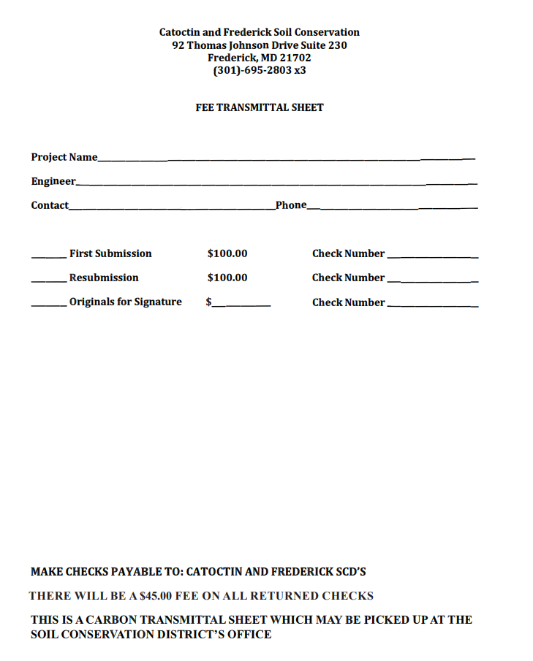
FEE TRANSMITTAL SHEET

Slide 8
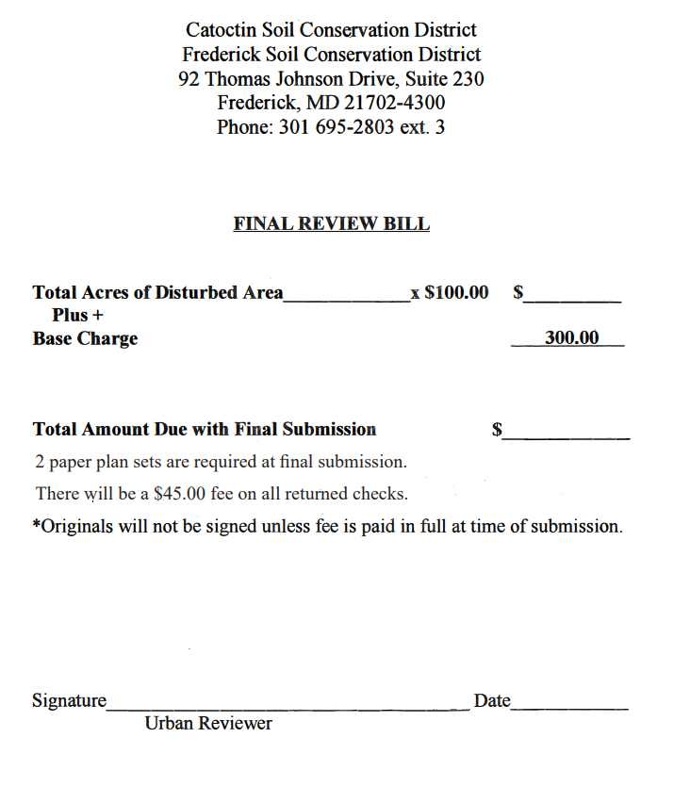
FINAL REVIEW BILL SHEET

Slide 9
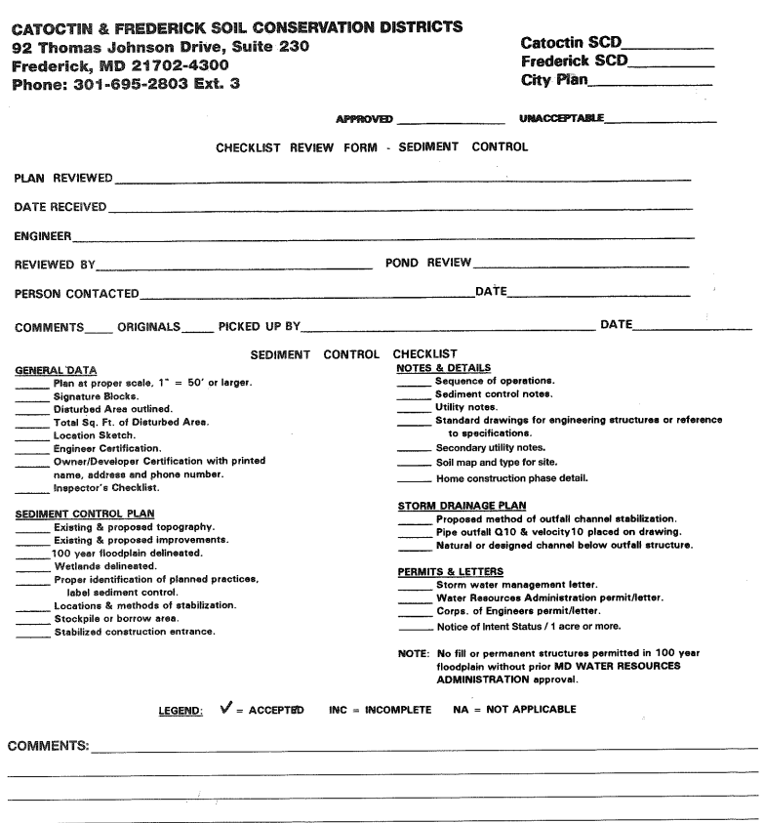
SOIL CONSERVATION DISTRICT REVIEW CHECKLIST

Slide 10
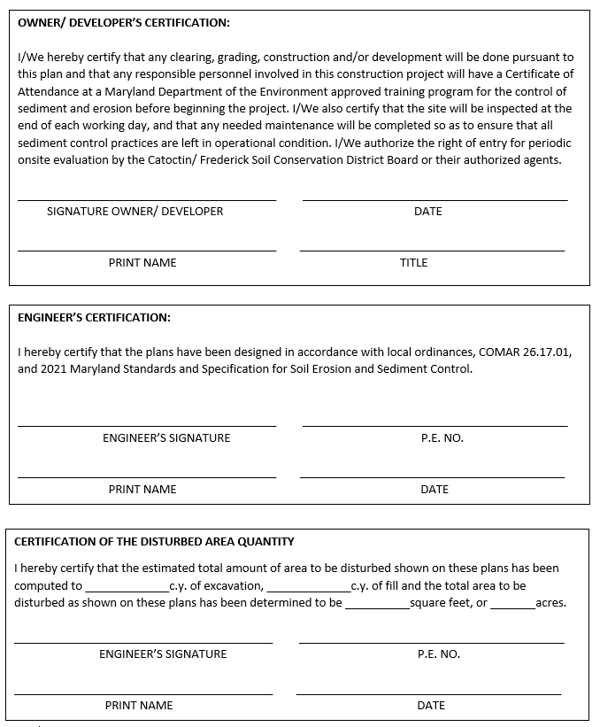
OWNER/DEVELOPER, ENGINEER, DISTURBED AREA CERTIFICATION BLOCKS

Slide 11
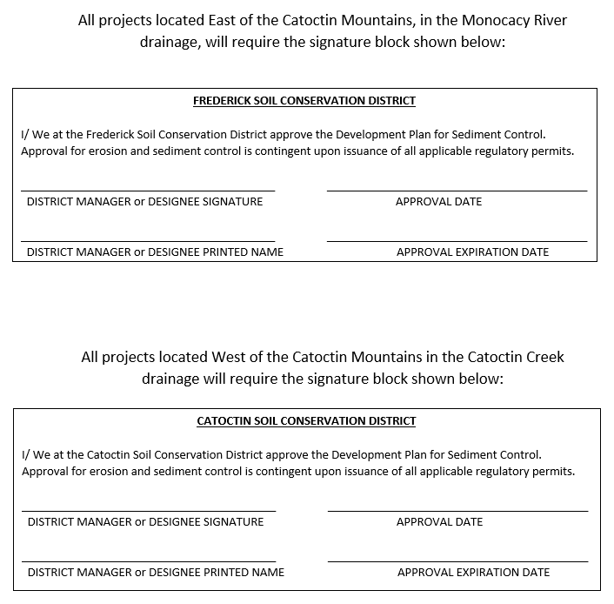
CATOCTIN & FREDERICK SOIL CONSERVATION DISTRICT SIGNATURE BLOCKS
*Signature blocks are required on cover sheet, each page of project applicable to sediment and erosion control or storm water management review.

Slide 12
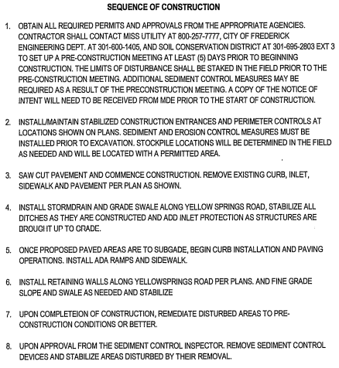
SEQUENCE OF CONSTRUCTION SAMPLE

Slide 13
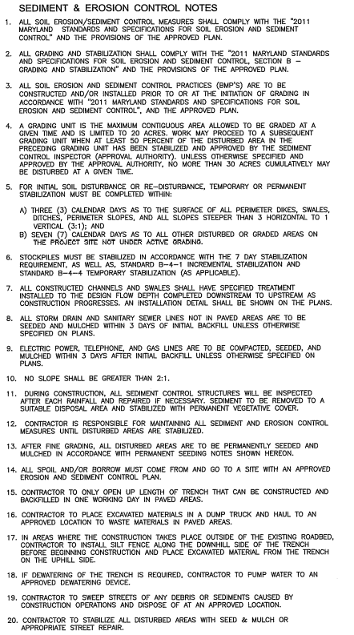
SEDIMENT AND EROSION CONTROL NOTE SAMPLE

Slide 14
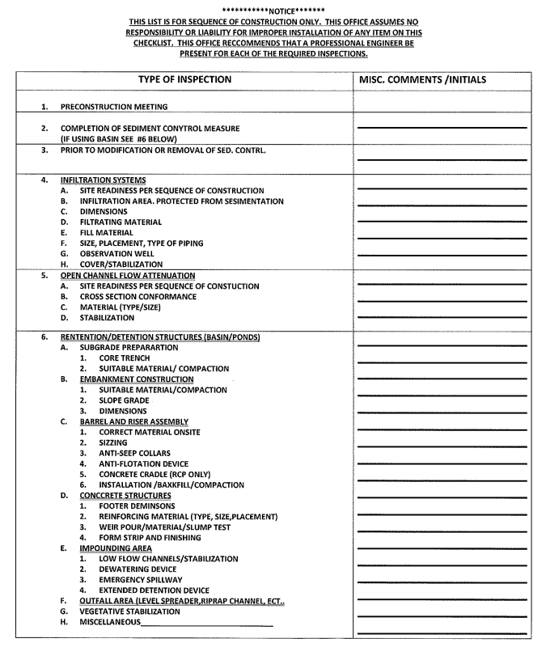
SEDIMENT CONTROL/ STORMWATER MANAGEMENT REQUIRED INSPECTION SAMPLE

Slide 15
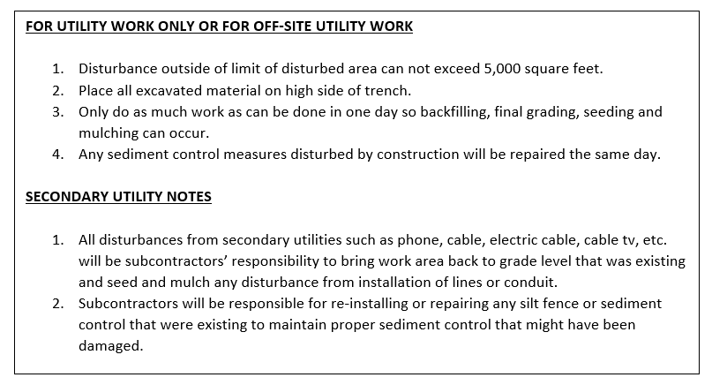
UTILITY WORK AND SECONDARY UTILITY NOTES SAMPLE

Slide 16
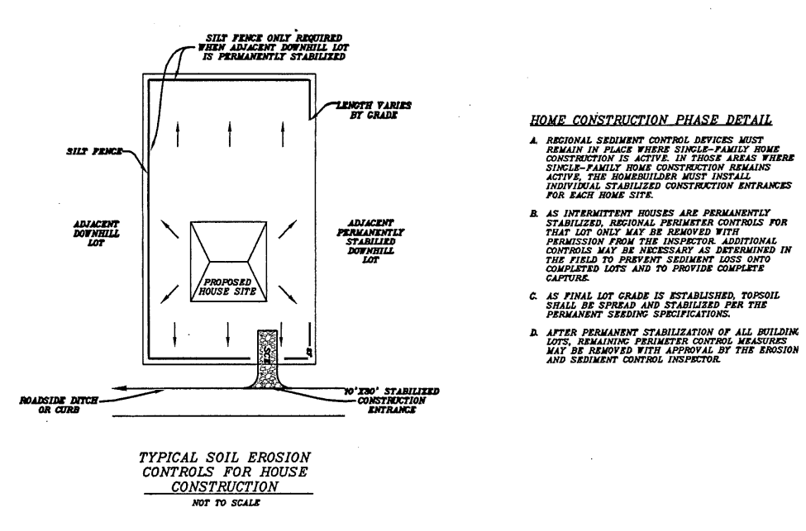
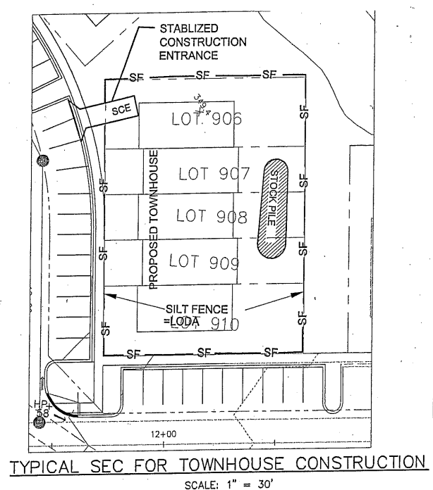
HOME CONSTRUCTION PHASE DETAIL SAMPLE

Slide 17
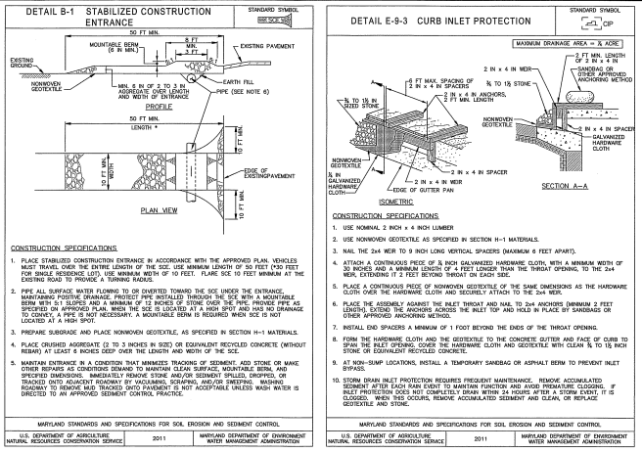
STANDARD DRAWING FOR ENGINEERING STRUCTURES OR REFERENCE TO SPECIFICATIONS

Slide 18
AS-BUILT INFORMATION REQUIRED ON A COPY OF ORIGINAL PLANS
SHOW THE FOLLOWING IN RED INK:
Profile of top of dam.
Cross-section of the emergency spillway at the control section.
A profile along the centerline of the emergency spillway and survey topo shot on all four corners of the level section.
A profile of the dam along the centerline of the principal spillway extending at least 100 feet downstream of the fill, to include elevation of the principal spillway crest and barrel invert (inlet and outlet).
The size and elevation of any low stage orifices.
Diameter, length and type of material for the riser and conduit.
The size and types of anti-vortex/trash rack device and its height in relation to the principal spillway crest.
The number, size and location of the anti-seep collars.
Show the contours and the survey topo shots of the pool area so that design volume can be verified.
A certification statement signed and sealed by a Maryland registered Professional Engineer stating, “ I hereby certify that this As-built is accurate and completed and that the pond as constructed meets the requirements of NRCS Standards and Specifications for Ponds- 378.
A check mark may be made beside planned values if they were the actual constructed values. For changed values, line out the planned value and enter the actual value.
All sheets of original approved plan included and marked AS-BUILT.
Revised computations provided if installed structure if significantly changed from original design.
Elevations shown to the nearest 0.1’ are sufficient.

Slide 19
AS-BUILT INFORMATION REQUIRED ON A COPY OF ORIGINAL PLANS CONTINUED
*Note: Any major change or deviation from the original plan must be redesigned and revised plans submitted to Catoctin and Frederick Soil Conservation District prior to the performance of the work, or prior to approval of the AS-BUILT drawing.
In cases were constructed dimensions are different from those planned, two options are available:
Option 1) A redesigned showing the structure will provide planned functions and meet standards for dam safety.
Option 2) Submit a written explanation to why a redesign is not warranted. This may apply when constructed values are very newar planned dimensions.
It will be up to the individual engineer to decide what level of supervision is needed during construction.
The Catoctin and Frederick Soil Conservation District understands the problems that may arise in preparing AS-BUILT plans for ponds constructed prior to the notification of existing policy. Consideration will be given on a case by case basis. The Catoctin and Frederick Soil Conservation District are not, however, willing to approve AS-BUILT plans that do not show that the pond meets dam safety requirements.

Slide 20

USDA NATIONAL RESOURCES CONSERVATION SERVICES MARYLAND CONSERVATION PRACTICES STANDARD CODE NO. 378 POND
USDA Conservation Practice Standard Code No. 378 Pond

Slide 21
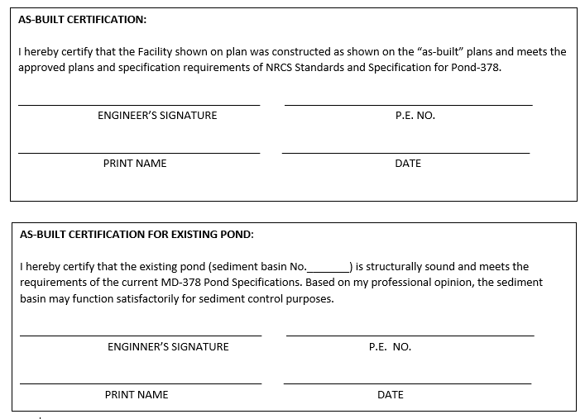
REQUIRED AS-BUILT CERTIFICATION BLOCKS

Slide 22
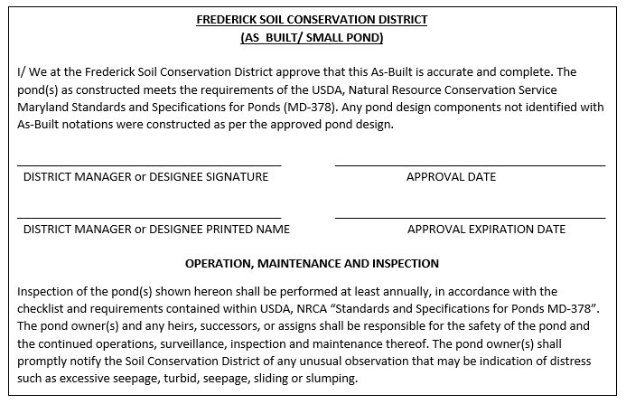
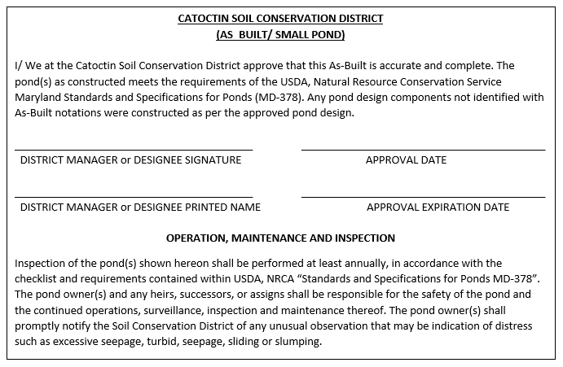
CATOCTIN & FREDERICK SOIL CONSERVATION DISTRICT
AS- BUILT APPROVAL SIGNATURE BLOCKS

Slide 23
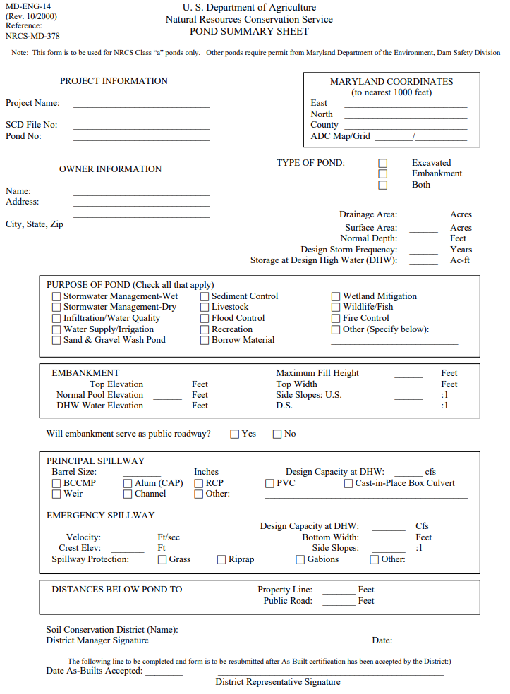
MD 14 POND SUMMARY SHEET SAMPLE
MD 14 Pond Summary Sheet

